Slide 1

An Introduction to Kotlin
Produced
by:
Dr. Siobhán Drohan (sdrohan@wit.ie)
Department of Computing and Mathematics
http://www.wit.ie/

Slide 2
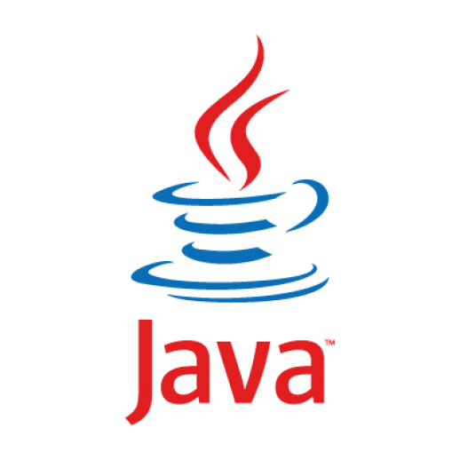
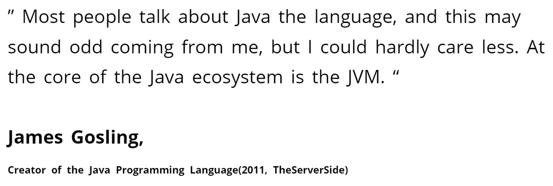


Slide 3
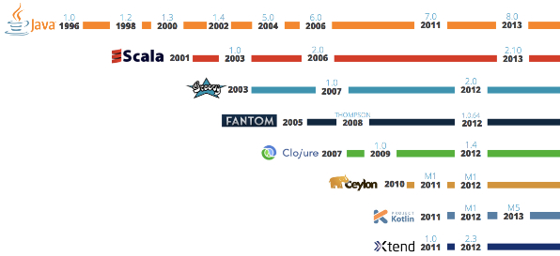
JVM Language History
Source

Slide 4


Created in 2011 by JetBrains, the creators of IntelliJ. On Object Oriented Language with Functional Constructs (e.g. lambdas).

Slide 5
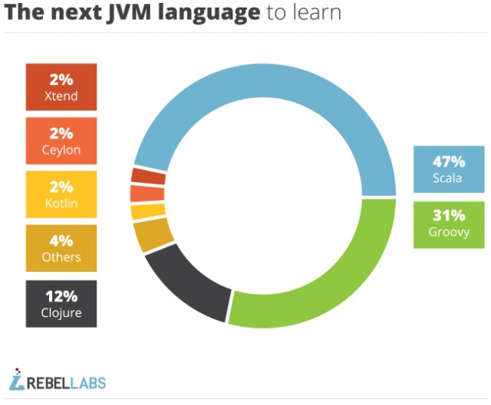
2014
Source

Slide 6
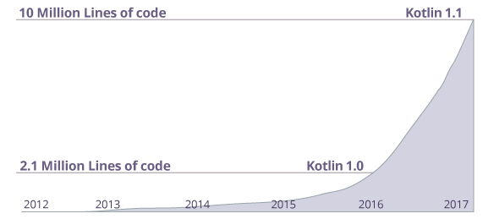
Many companies like Netflix, Uber, Trello, Pinterest, Corda etc. are using Kotlin (along with other programming languages) to create applications.
https://www.programiz.com/kotlin-programming

Slide 7
April 21st 2017

Slide 8

“Java is the primary and official language for Android development, but that doesn’t mean it is the best or the only choice.” “To give Java credit, it is a robust language that has been around for a while, but it comes with a specific set of challenges that can be a deterrent for developers.”
Source: Dzone, April 21st 2017

Slide 9
“A new breed of modern JVM languages is slowly gaining traction within the Android community, and Kotlin is leading the pack.”
Source: Dzone, April 21st 2017

Slide 10
May 17th 2017

Slide 11
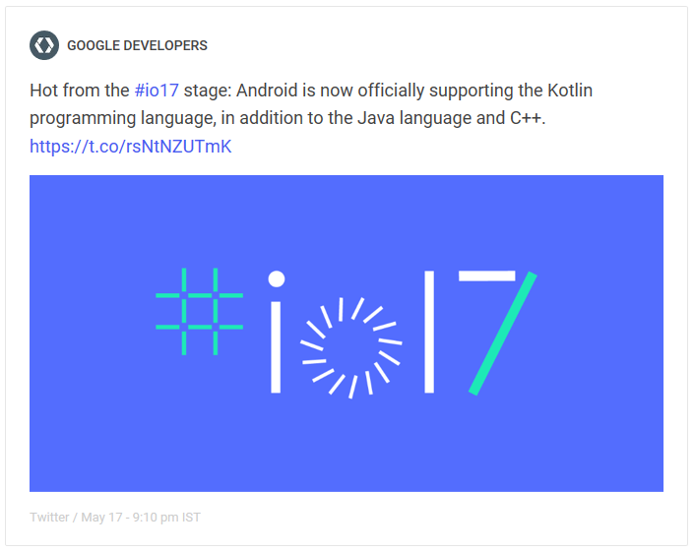

Slide 12

“For Android developers, Kotlin support is a chance to use a modern and powerful language, helping solve common headaches such as runtime exceptions and source code verbosity.
Kotlin is easy to get started with and can be gradually introduced into existing projects, which means that your existing skills and technology investments are preserved.”
https://blog.jetbrains.com/kotlin/2017/05/kotlin-on-android-now-official/

Slide 13
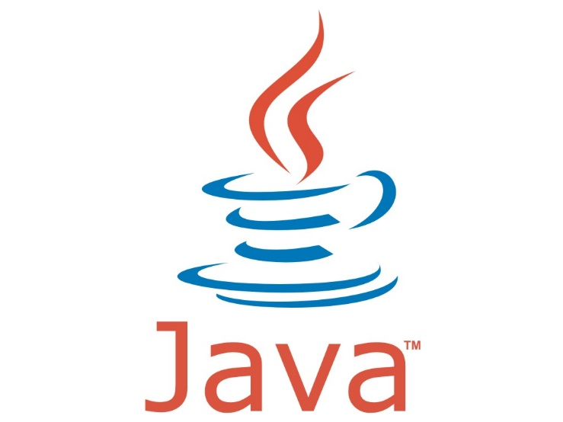
Kotlin Overview

Slide 14
runs on Java Virtual Machine.
is an evolution of the Java syntax but is more concise and has cleaner syntax.
is not syntax compatible with Java; but is interoperable with Java.
relies on some Java Class Libraries e.g. Collections framework.
is a statically-typed programming language.
offers null safety.
Based on : https://en.wikipedia.org/wiki/Kotlin_(programming_language)

Slide 15
runs on Java Virtual Machine.
is an evolution of the Java syntax but is more concise and has cleaner syntax.
is not syntax compatible with Java; but is interoperable with Java.
relies on some Java Class Libraries e.g. Collections framework.
is a statically-typed programming language.
offers null safety.
Based on : https://en.wikipedia.org/wiki/Kotlin_(programming_language)

Slide 16
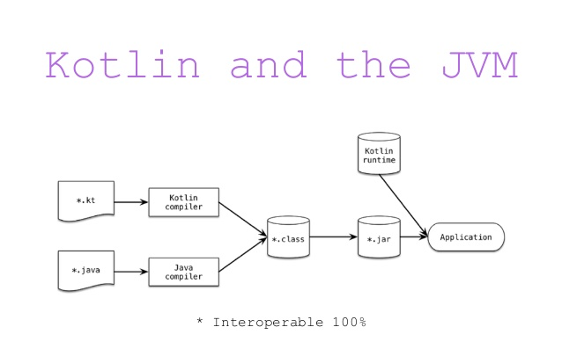
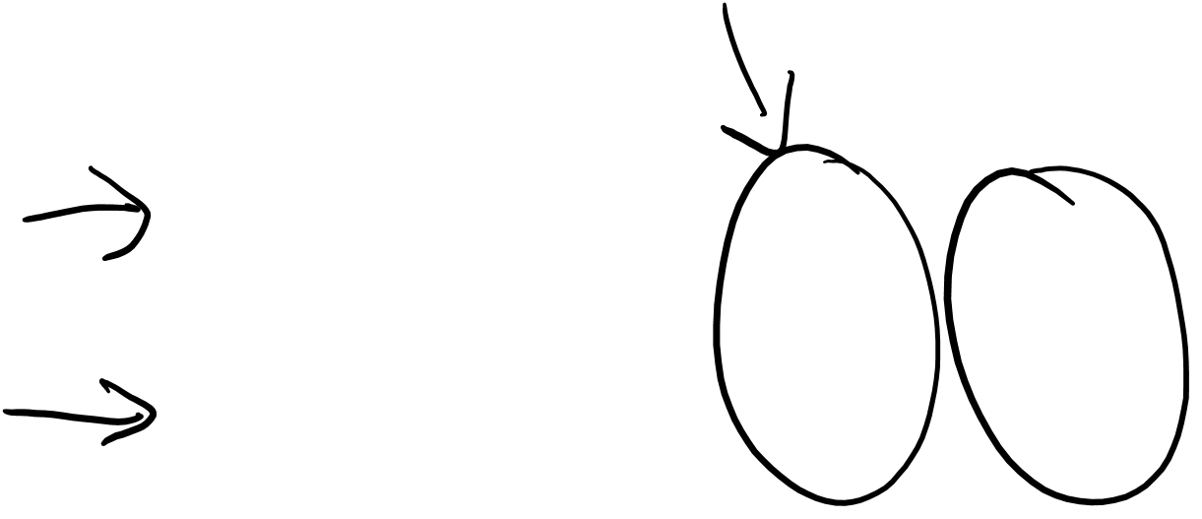
Runs on Java Virtual Machine
Kotlin compiles to JVM ByteCode (like Java)
Note: Kotlin also compiles to JavaScript

Slide 17
runs on Java Virtual Machine.
is an evolution of the Java syntax but is more concise and has cleaner syntax.
is not syntax compatible with Java; but is interoperable with Java.
relies on some Java Class Libraries e.g. Collections framework.
is a statically-typed programming language.
offers null safety.
Based on : https://en.wikipedia.org/wiki/Kotlin_(programming_language)

Slide 18
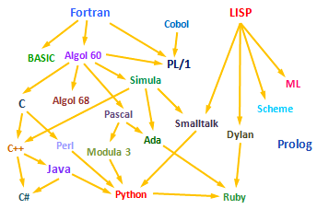

JVM Language Evolution
Objective-C
Scala
Groovy
Swift
Xtend
Go
Kotlin

Slide 19
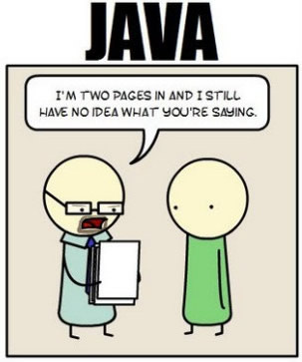
Kotlin (Concise) Vs Java (Overly Verbose)
“Java is extremely verbose and ceremonious. Programmers need to write reams of code to get a simple task done. There's a great deal of ‘ceremony’ in Java APIs, and Android aggravates this by forcing developers to go through many steps, in a specific order, to get things done.”
Source: https://dzone.com/articles/why-you-should-consider-kotlin-for-android-develop?fromrel=true

Slide 20
Kotlin (Concise) Vs Java (Overly Verbose)
“Java code is verbose…”
“Kotlin provides a well thought-out syntax and extensive standard library that removes many of the pain points that exist in Java.”
Source: https://medium.com/keepsafe-engineering/lessons-from-converting-an-app-to-100-kotlin-68984a05dcb6

Slide 21
Kotlin (Concise) Vs Java (Overly Verbose)
Rough estimates indicate approximately a 40% cut in the number of lines of code.
https://kotlinlang.org/docs/reference/faq.html

Slide 22
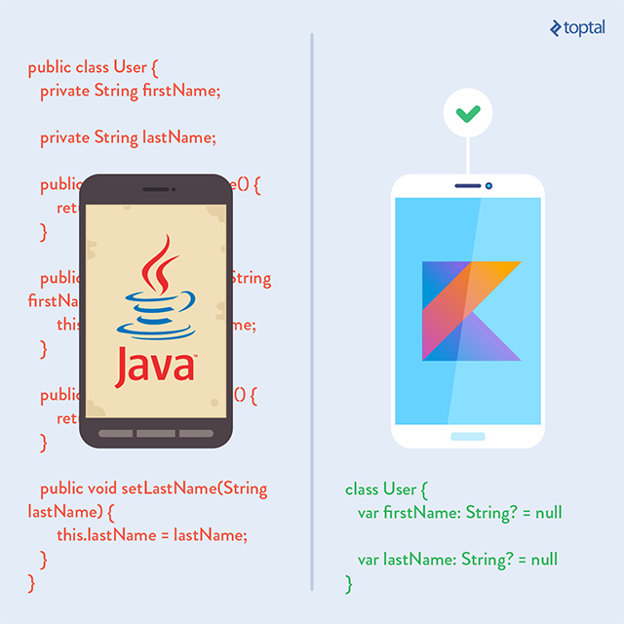

Kotlin (Concise) Vs Java (Overly Verbose)
Koltin drastically reduces the amount of boilerplate code you have to write.
The less code you write, the fewer mistakes you make, the less to test, the better the execution.

Slide 23
Easy(ish) learning curve for Java Developers
“Kotlin is approachable and can be acquired in a few hours by simply reading the language reference. It has a lean and intuitive syntax.”
“Kotlin is also designed to have a gentle learning path for Java developers. Java programmers will find that most of the Kotlin syntax feels familiar.”
https://dzone.com/articles/why-you-should-consider-kotlin-for-android-develop?fromrel=true

Slide 24
runs on Java Virtual Machine.
is an evolution of the Java syntax but is more concise and has cleaner syntax.
is not syntax compatible with Java; but is interoperable with Java.
relies on some Java Class Libraries e.g. Collections framework.
is a statically-typed programming language.
offers null safety.
Based on : https://en.wikipedia.org/wiki/Kotlin_(programming_language)

Slide 25
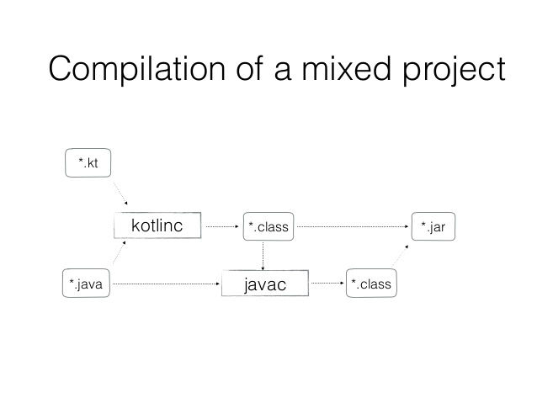
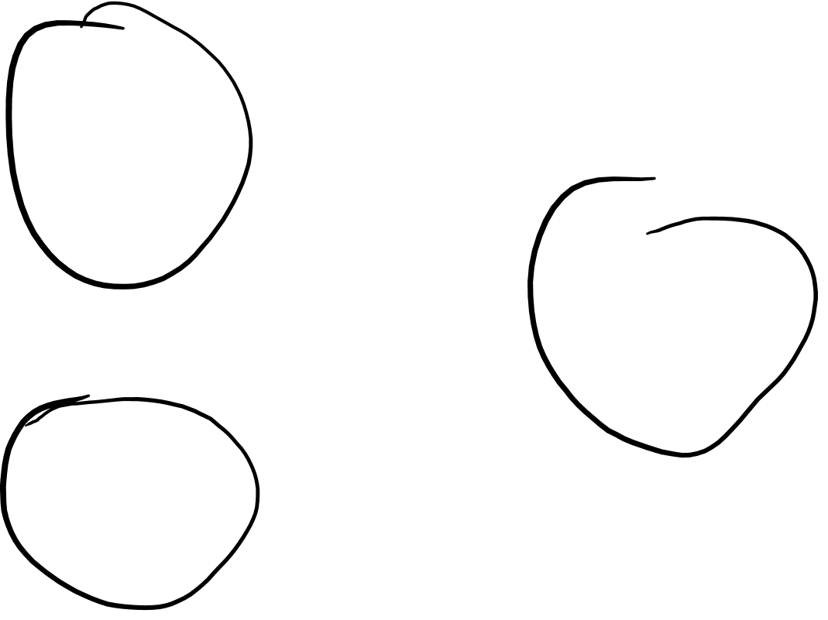
Kotlin / Java Interoperability

Slide 26
Kotlin / Java Interoperability
Kotlin and Java are 100% interoperable; Java and Kotlin code can co-exist very well in the same project and compile perfectly.
Kotlin can be called from Java and Java from Kotlin.
Both .java and .kt files are compiled to .class bytecode.
When a project containing both Java and Kotlin is compiled, it would be difficult to tell which parts were created in Java and which in Kotlin.
You can start using Kotlin in an existing Java project, without having to convert the project to Kotlin.
https://dzone.com/articles/why-you-should-consider-kotlin-for-android-develop?fromrel=true

Slide 27
runs on Java Virtual Machine.
is an evolution of the Java syntax but is more concise and has cleaner syntax.
is not syntax compatible with Java; but is interoperable with Java.
relies on some Java Class Libraries e.g. Collections framework.
is a statically-typed programming language.
offers null safety.
Based on : https://en.wikipedia.org/wiki/Kotlin_(programming_language)

Slide 28
Kotlin and the Java Class Libraries
Interoperability advantages:
you can use any of the vast number of Java Libraries and Frameworks in a Kotlin project.
Kotlin can also easily integrate with Maven, Gradle and other build systems.
https://dzone.com/articles/why-you-should-consider-kotlin-for-android-develop?fromrel=true
https://www.xenonstack.com/blog/overview-of-kotlin-comparison-between-kotlin-java

Slide 29
runs on Java Virtual Machine.
is an evolution of the Java syntax but is more concise and has cleaner syntax.
is not syntax compatible with Java; but is interoperable with Java.
relies on some Java Class Libraries e.g. Collections framework.
is a statically-typed programming language.
offers null safety.
Based on : https://en.wikipedia.org/wiki/Kotlin_(programming_language)

Slide 30
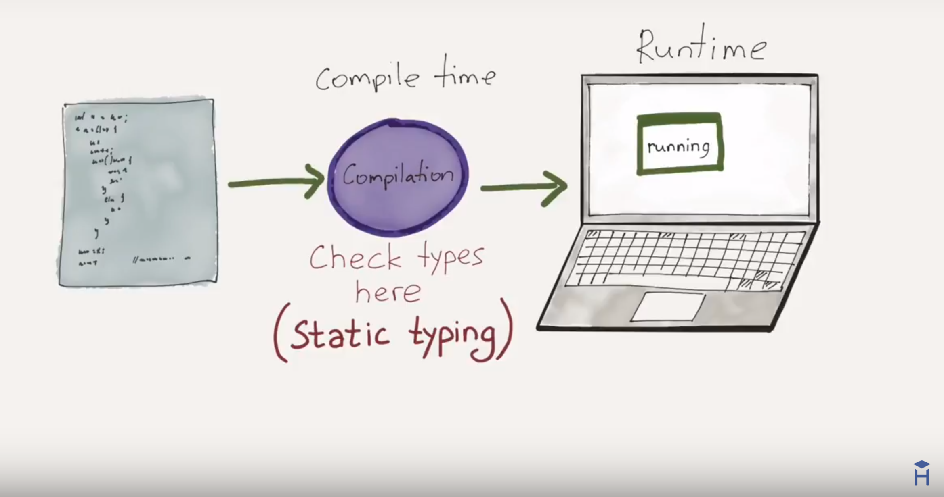

STATIC TYPING
“Variable declarations are mandatory before usage,
else results in a compile-time error"

Slide 31
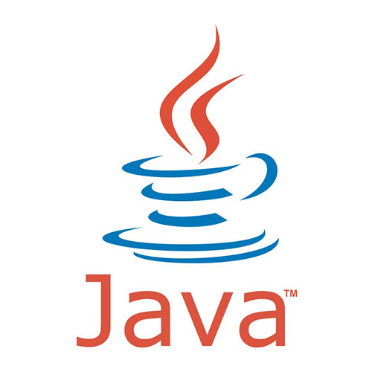

Static Typing – Example
String greeting = "Hello!";
int someRandomInteger = 100;
double aDoubleVariable = 2.2;
In Java, if we don’t assign a type, we get a compiler error → Java is statically typed.
Types determine the operations we can perform on the variables.
A type is assigned to each variable.
https://howtoprogramwithjava.com/dynamic-typing-vs-static-typing/

Slide 32

Static Typing – Example
In Kotlin, you don’t have to specify the type of each variable explicitly, even though Kotlin is statically-typed.
Here, Kotlin determines the type from the initialisation.
fun main(args : Array<String>)
{
var someRandomInteger = 100
var aDoubleVariable = 2.2
println (someRandomInteger)
println (aDoubleVariable)
}
http://petersommerhoff.com/dev/kotlin/kotlin-for-java-devs/#type-inference

Slide 33

Static Typing – Example
However, you can choose to explicitly define a data type.
fun main(args : Array<String>)
{
var someRandomInteger : Int = 100
var aDoubleVariable : Double = 2.2
println (someRandomInteger)
println (aDoubleVariable)
}

Slide 34

Static Typing – Example
With Kotlin, you have to either define a type or initialise the variable (kotlin then determines the type!).
fun main(args : Array<String>)
{
var someRandomInteger //compile error
var aDoubleVariable : Double = 2.2
println (someRandomInteger)
println (aDoubleVariable)
}
http://petersommerhoff.com/dev/kotlin/kotlin-for-java-devs/#type-inference

Slide 35

Static Typing – Example
fun main(args : Array<String>)
{
var someRandomInteger : Int = 100
var aDoubleVariable : Double = 2.2
someRandomInteger = 2.65 //compile error
aDoubleVariable = 233 //compile error
println (someRandomInteger)
println (aDoubleVariable)
}
http://petersommerhoff.com/dev/kotlin/kotlin-for-java-devs/#type-inference

Slide 36
runs on Java Virtual Machine.
is an evolution of the Java syntax but is more concise and has cleaner syntax.
is not syntax compatible with Java; but is interoperable with Java.
relies on some Java Class Libraries e.g. Collections framework.
is a statically-typed programming language.
offers null safety.
Based on : https://en.wikipedia.org/wiki/Kotlin_(programming_language)

Slide 37
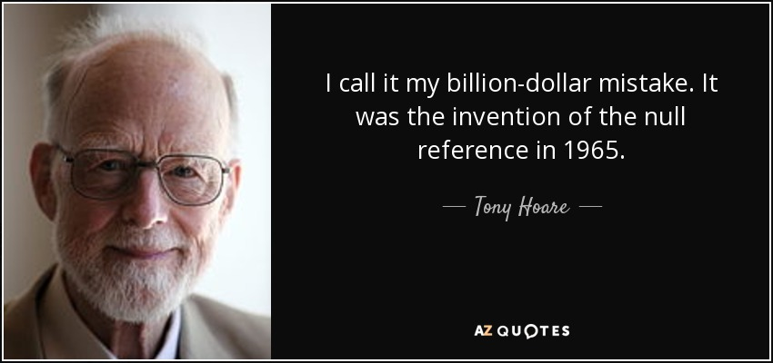
Null – Billion Dollar Mistake

Slide 38
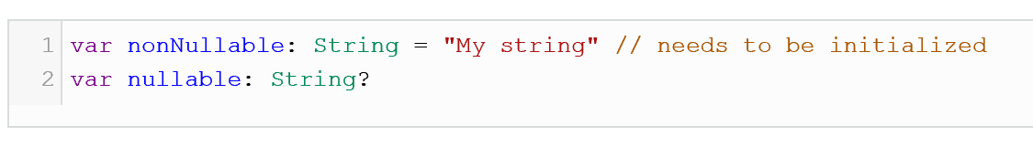

Kotlin and Null Safety
Kotlin eliminates most sources of null references by making all types non-nullable by default — meaning that the compiler won’t let you use a non-initialized, non-nullable variable.
If you need a variable to hold a null value, you have to declare the type as nullable, adding a question mark after the type (more on this in later lectures).
Source: https://dzone.com/articles/kotlin-vs-java-first-impressions-using-kotlin-for

Slide 39


Slide 40
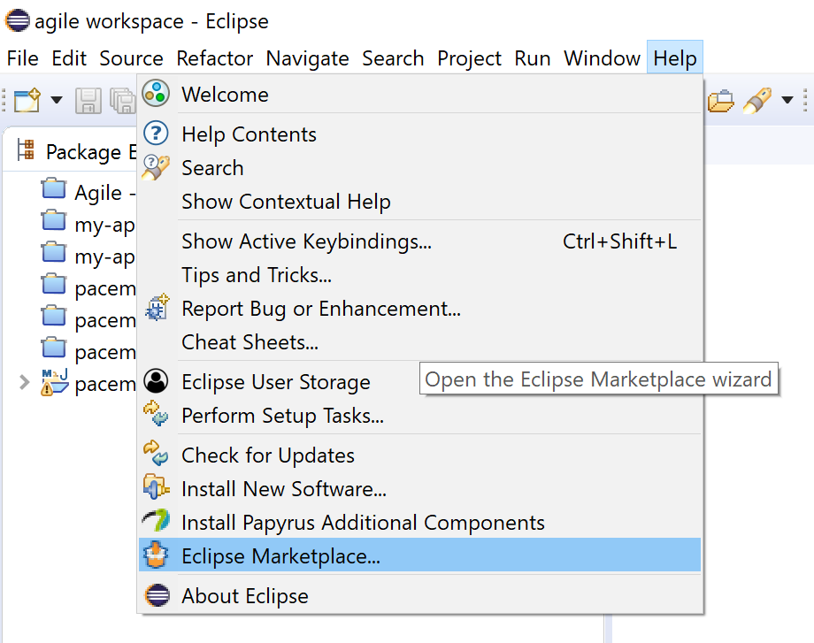
Install Kotlin plugin into Eclipse

Slide 41
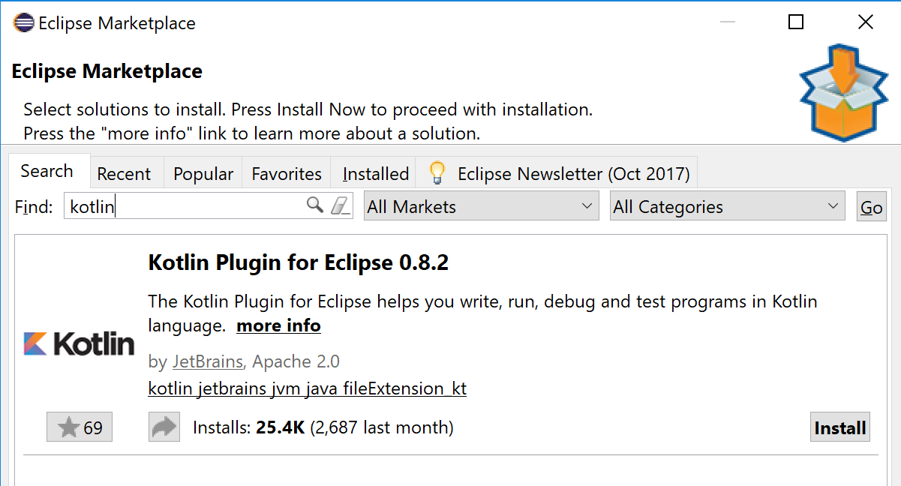

Install Kotlin plugin into Eclipse

Slide 42
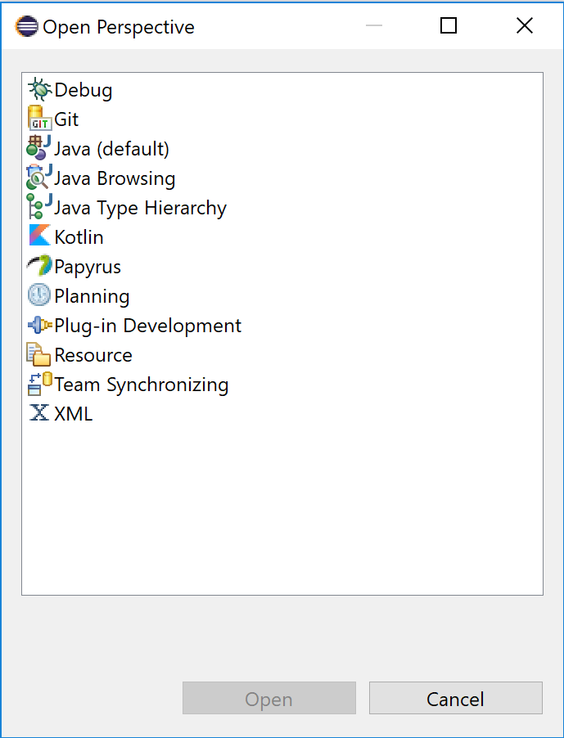

Change perspective to Kotlin.
Install Kotlin plugin into Eclipse

Slide 43
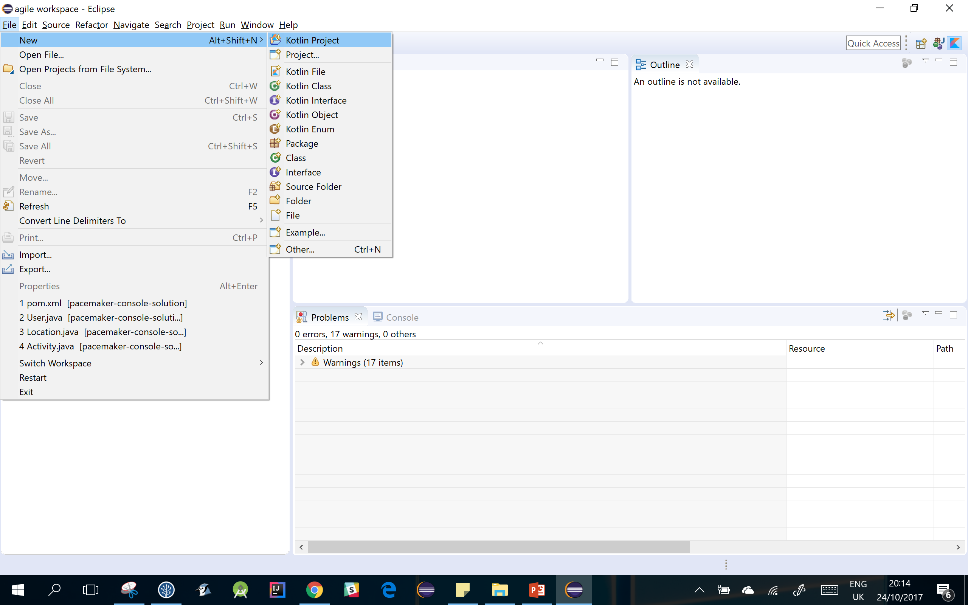

Create a new Kotlin project

Slide 44
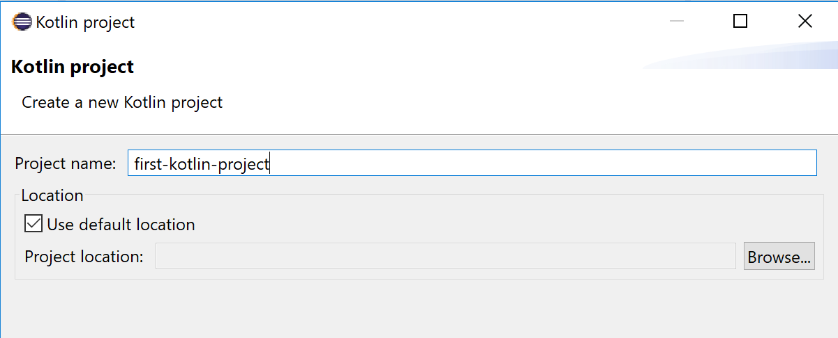
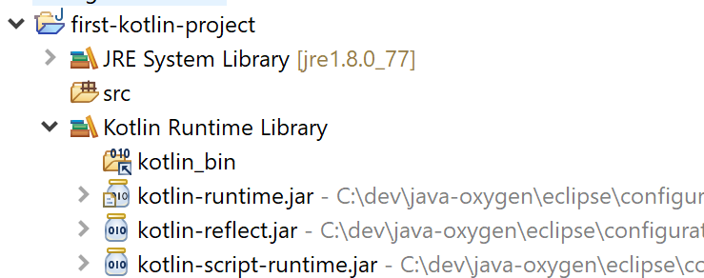

Create a new Kotlin project

Slide 45
Eclipse project is also a Java project with a:
Kotlin Builder and
Kotlin Runtime Library.
Can add Java classes to the project, mixing and
matching Kotlin and Java code where required.
Create a new Kotlin project

Slide 46
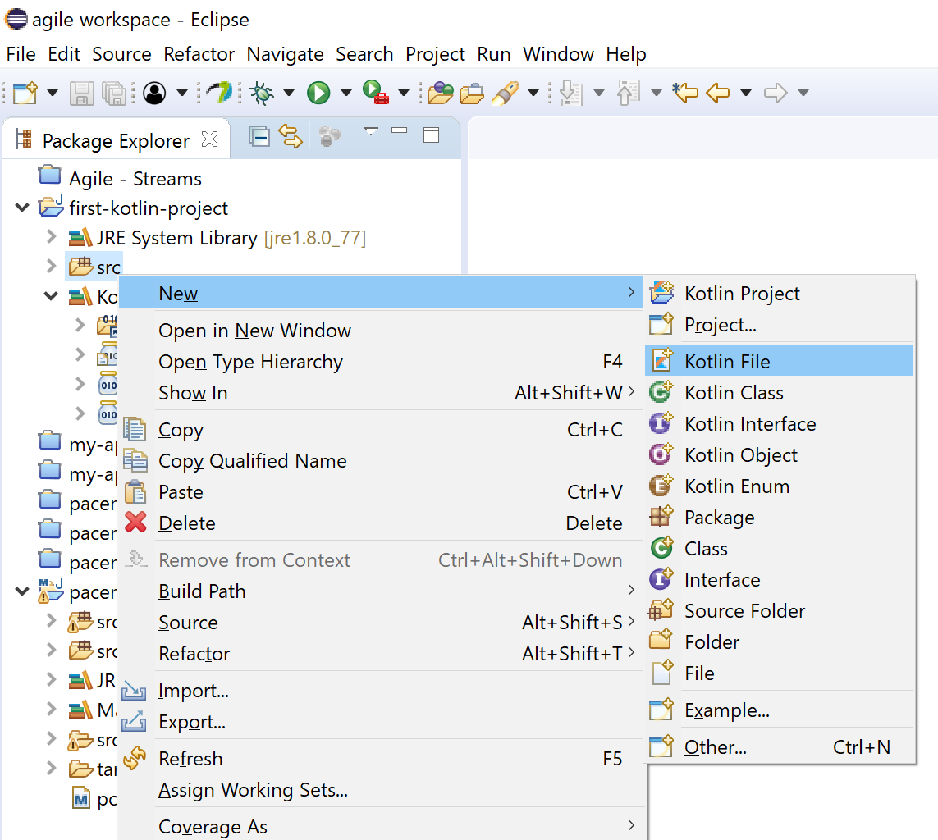
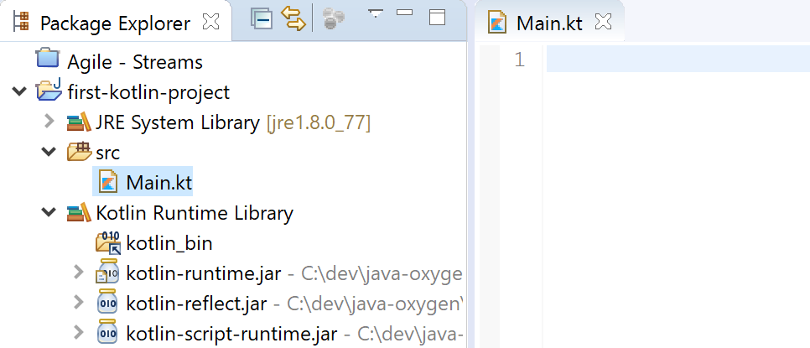
Create a new Kotlin file

Slide 47
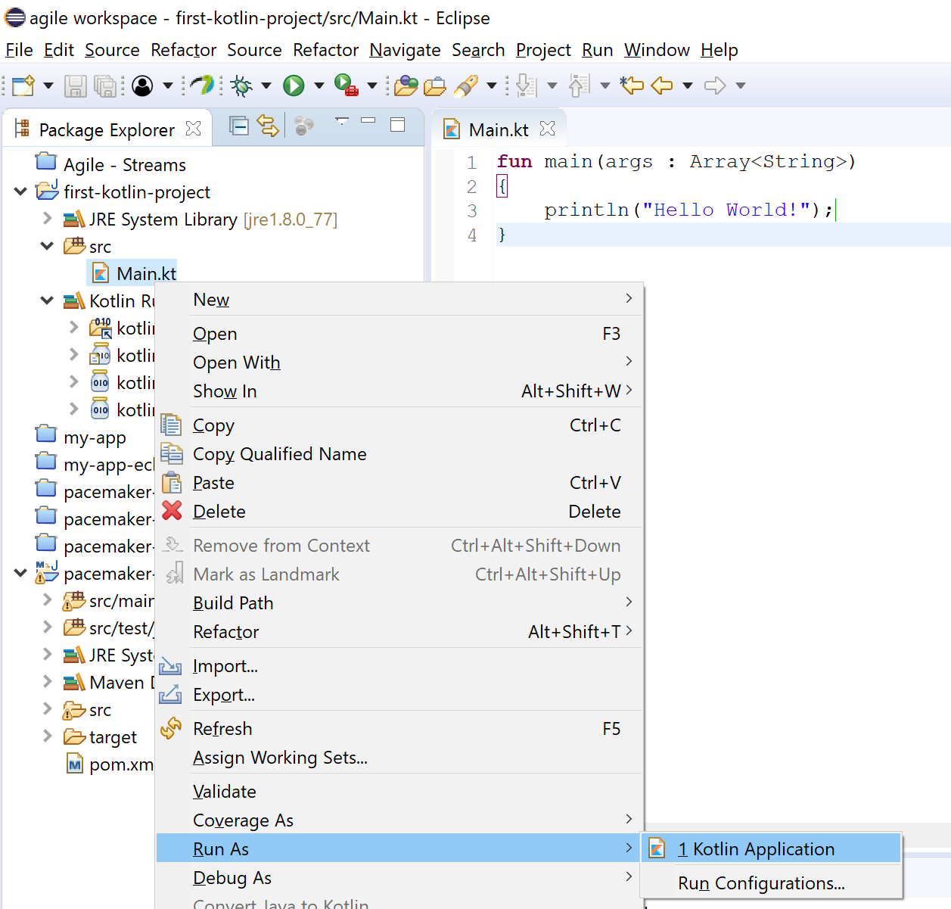

Hello World!

Slide 48
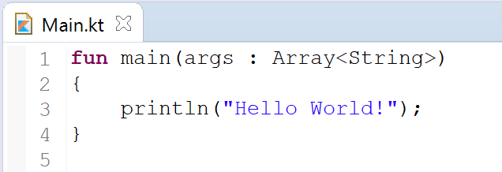
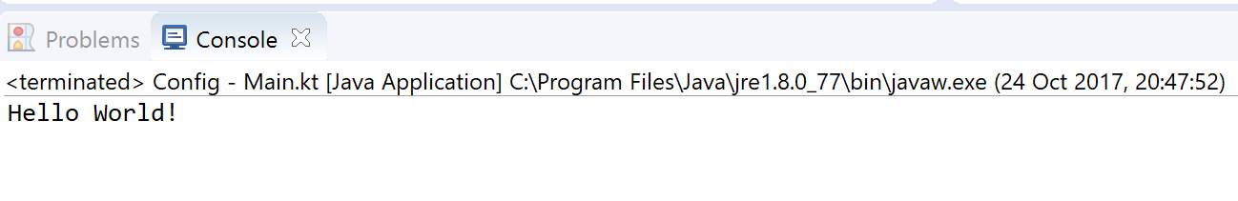
Hello World!

Slide 49
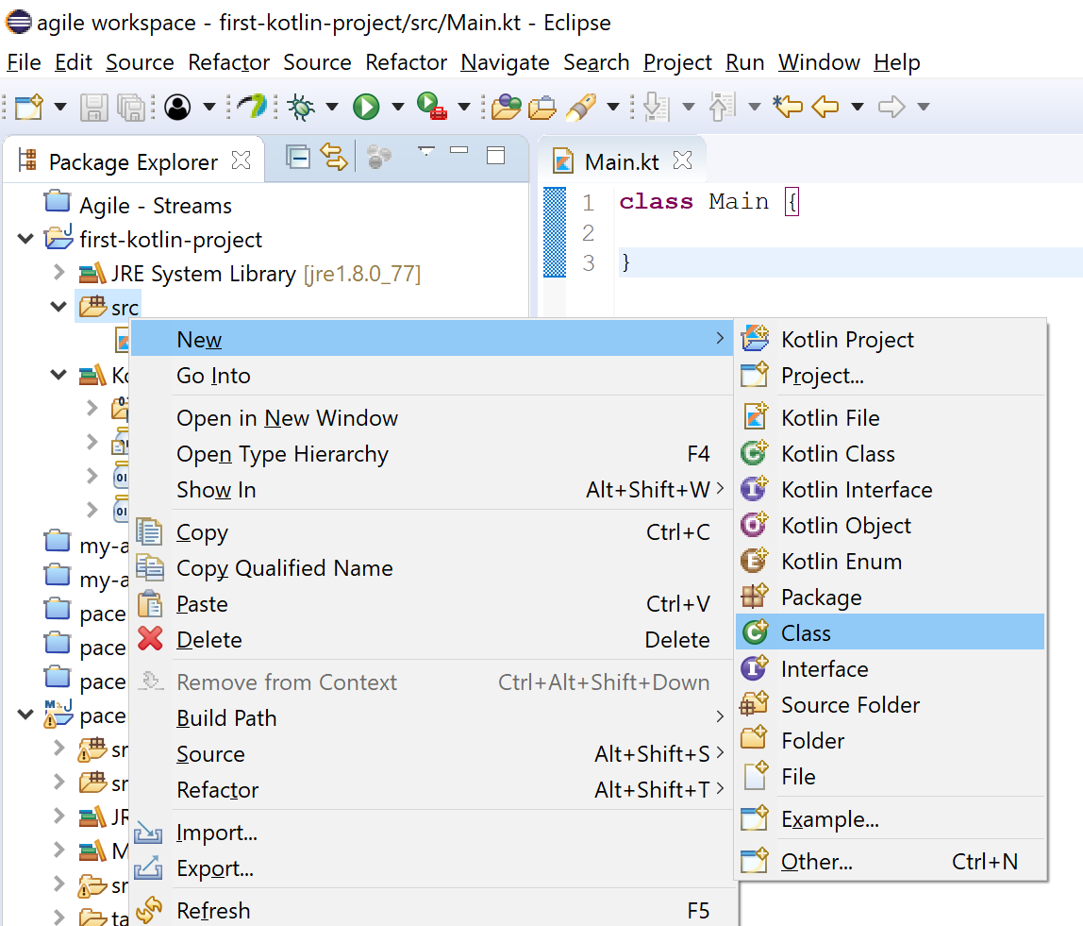
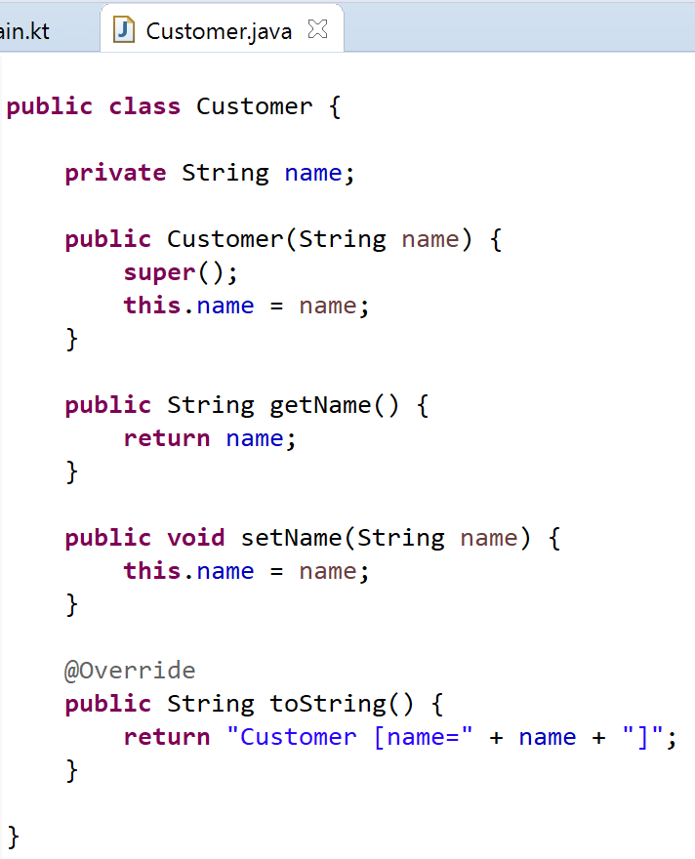

Interoperability:
Create a new Java class

Slide 50
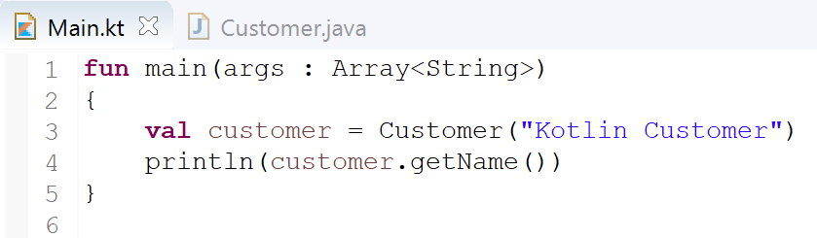
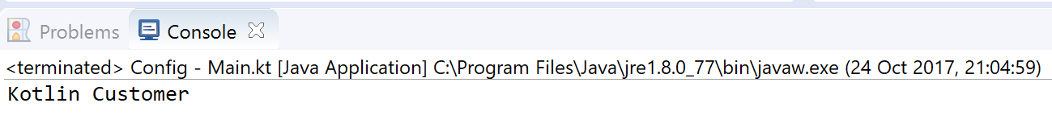

Interoperability:
Create a new Java class

Slide 51
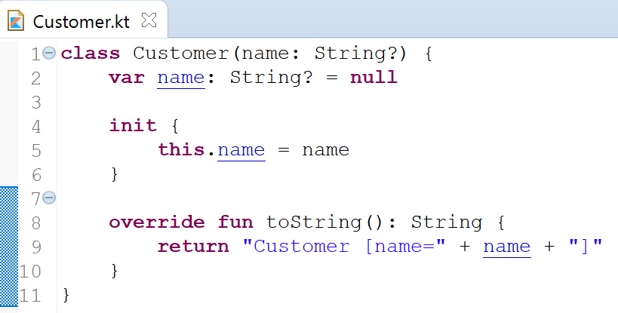

Kotlin Vs Java

